Slide 1

INSTITUTE OF ENGINEERING AND TECHNOLOGY, LUCKNOW
DEPARTMENT OF ELECTRONICS ENGINEERING
PLACEMENT BROCHURE
2019-20
placement@ietlucknow.ac.in
www.ietlucknow.ac.in

Slide 2
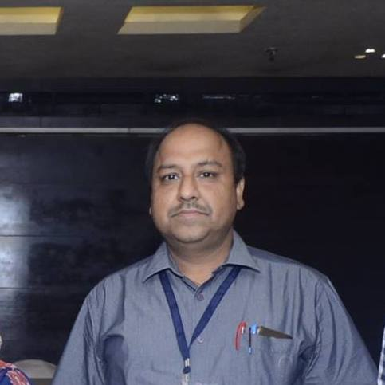
Message from
THE HEAD OF DEPARTMENT
Welcome to the department of Electronics Engineering at IET Lucknow. Our journey started in the year 1984. Over the last three decades, we have developed our expertise and competence in the core Electronics engineering curriculum and research.
The department put forwards undergraduate programme in Electronics and Communication Engineering and Electronics and Instrumentation Engineering, along with this post-graduate programmes include the specialisation in Microelectronics. The department aims at imparting technical knowledge of curriculum through a nice blend of coursework and projects and endows students with the ability to apply knowledge of science, mathematics and engineering to work effectively in multidisciplinary team, provide leadership and technical expertise and practice engineering with an ethical approach and concern to build a better tomorrow.
Highly qualified faculty members with surplus credentials conjointly work with unceasing efforts towards our students, helping them to learn, grow, develop and achieve their goals in their pursuit to excel in their professional career, imparting training of highest standards to the students ,in the field of electronics , thus preparing them to meet the demands of highly competitive global industrial market.
For any additional information, please do not hesitate to contact us.
Dr.Subodh Wariya
Head, Electronics Engineering
Department
subodh.wariya@ietlucknow.ac.in

Slide 3
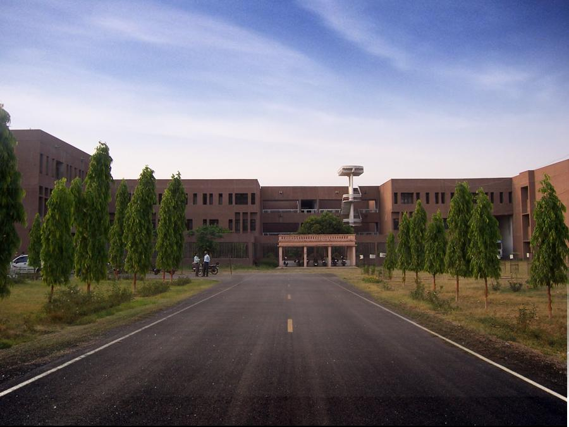
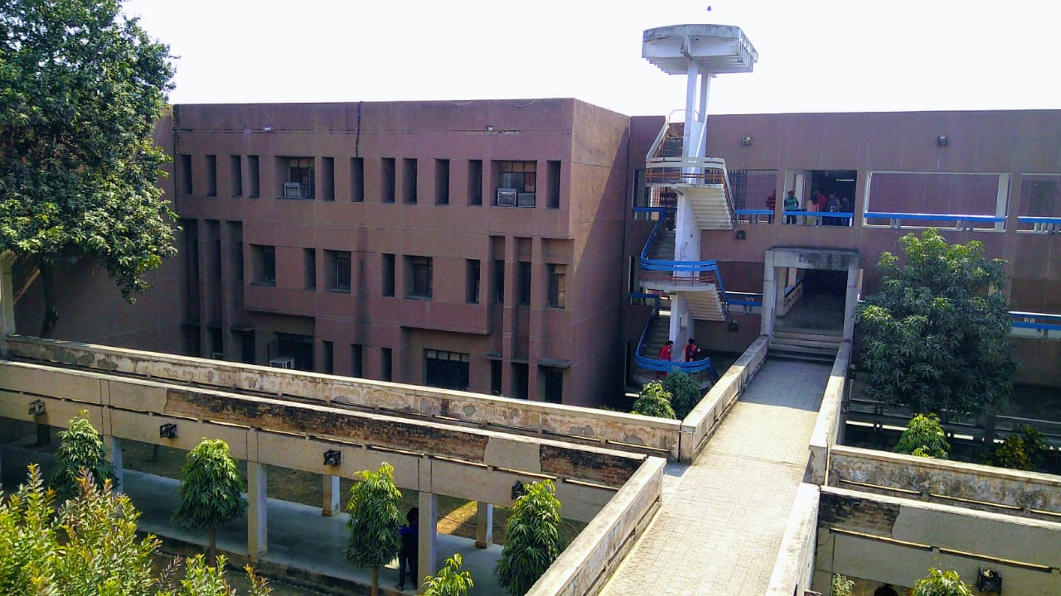
CONTENTS
About the Department
Courses Offered
Hands On
SEED Society
Robotics Club
Faculties’ Achievements
Industries we Fit in
Achievements & Tech Life
Training and Internships
Past Recruiters
Contact Us
Reach Us

Slide 4
ABOUT THE DEPARTMENT
The Electronics Department is an integral part of the IET. The Department of Electronics Technology is one of the oldest departments of this college, established in 1984. It produces graduates, postgraduates and researchers of excellent calibre. The department offers undergraduate programme in Electronics and Communication Engineering and Electronics and Instrumentation Engineering, along with this post graduate programmes include the specialisation in Microelectronics.
Vision:
The Department of Electronics Engineering envisions the upliftment of students, through an effective teaching learning process and quality research, to make them competent globally with sound technical, interpersonal, analytical, managerial skills and professional ethics. The department emphasises on providing academic environment that promotes creative thinking, team work and research and to enable the students to face societal challenges and provide holistic solutions.
Mission:
To provide the students an environment of academic freedom that will insure the exchange of ideas and the dissemination of knowledge in this discipline through effective teaching.
It infuses the scientific temper in the students towards the research in core Electronics engineering.
Offering well-balanced curriculum to acquire professional competencies.
Developing state of-the-art infrastructure and research for effective teaching learning process and quality research..
Strengthening of soft skills , through co-curricular & extra-curricular activities.

Slide 5
Courses Offered
Electronic Devices and Circuits
Digital Logic Design
Microprocessor 8085 8086
Microcontroller MSP430
Electronic Measurements and Instrumentation
Digital Signal Processing
IC Technology
Analog Communication System
Digital Communication System
Microwave Engineering
Antenna and Wave Propagation
Artificial Neural Network
Radar
Network Analysis and Circuits
Data Structures and Algorithms
Cyber Security
Manufacturing process
VLSI Design
Data Communication Network
Optical communication
Wireless and Mobile Communication
Optical Networks

Slide 6
“Hands On”
Electronics Engineering lab
PCB & Workshop Design Lab
Analog Electronics (Linear Integrated Circuits) Lab
Digital Electronics Lab
Microprocessor Lab
Microcontrollers Lab
Embedded Systems Lab
CAD Lab
Control Systems Engineering Lab
Communication Engineering Lab
Advanced Communication Engineering Lab
Microwave Engineering Lab
Optical Fiber Communication Lab
Digital Signal Processing Lab
Electronic Measurement & Instrumentation Lab
Transducer & Sensor Lab
Industrial Instrumentation & Control Lab
Analog Signal Processing (Microelectronics Circuit Design) Lab
VLSI Lab

Slide 7
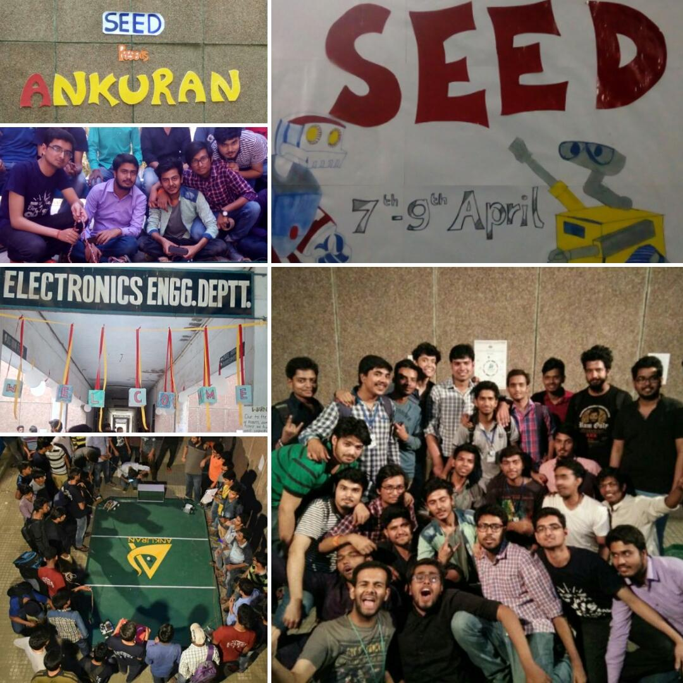
Society for Electronics Exploration and Development, IET Lucknow
It took roots in the year 2016 and has been nurturing young brains ever since in developing a comprehensive approach towards the learning of robotics and advanced circuitry.
The society involves pursuing career-oriented activities and courses that develop an individual to take on the fierce competition of the corporate world.

Slide 8
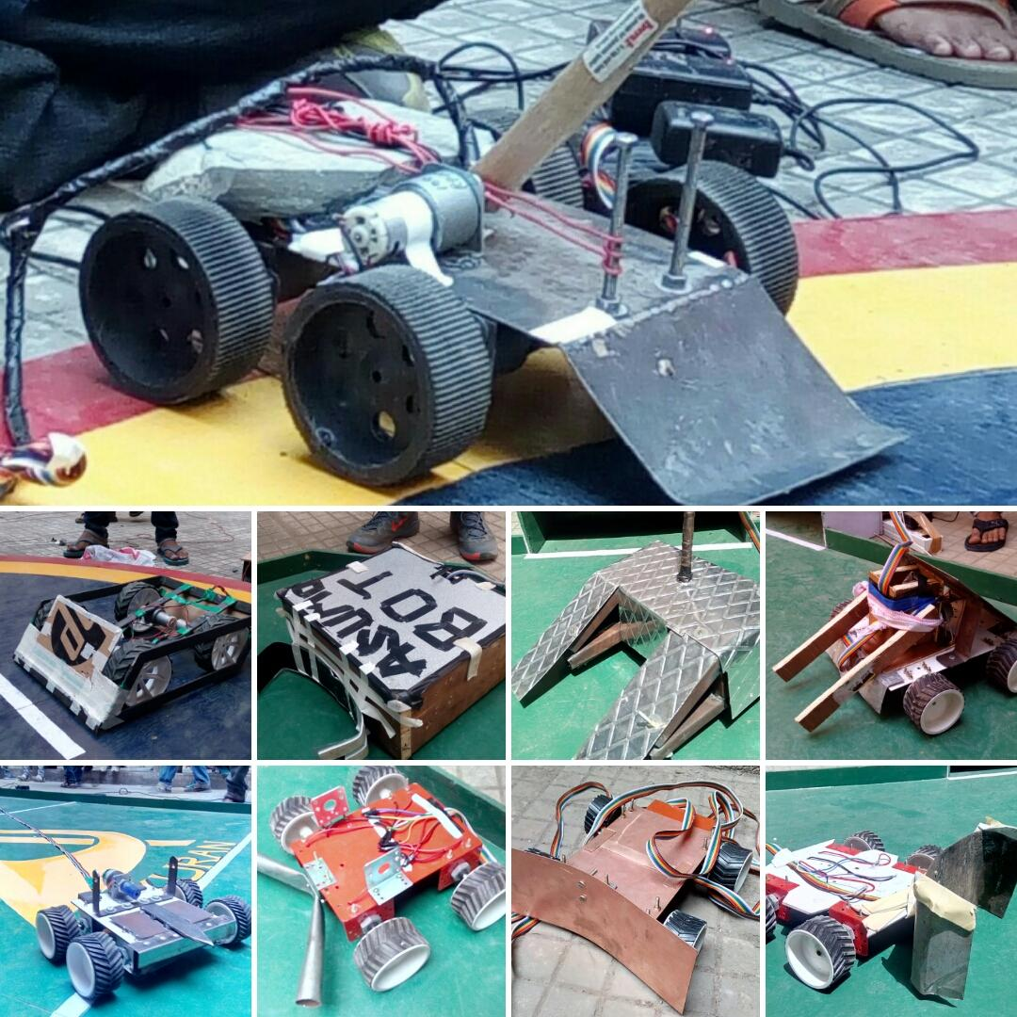
Robotics Club
A drive initiated from the urge of students to excel in the field of Robotics through blending breakthrough technologies with continued efforts.
The club has seen great success so far and have bagged prizes at reputed contests at IITs. Some testimonies of their sheer talent and hardwork are Aircraft prototypes, RC Car, Plane, Manual and Autonomous Bots, Drone, Quadcopter to name a few.

Slide 9
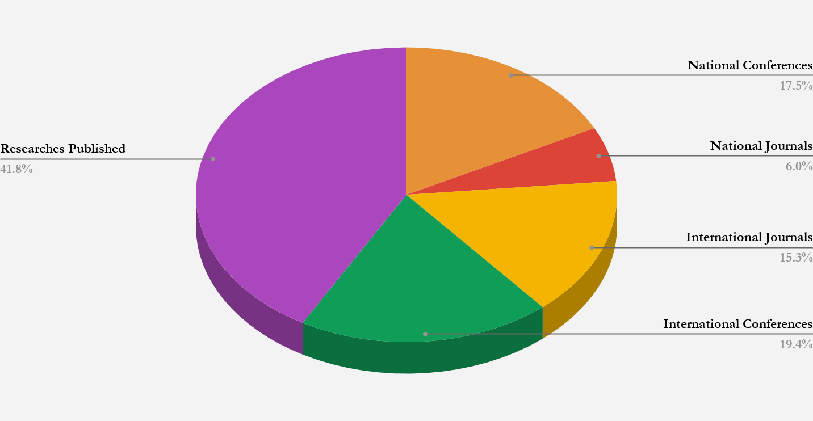
Our Faculties’ Global Achievements
A representation of the high standards and rigorous work put in by our faculties / instructors.

Slide 10
Industries we fit in
Taking a step ahead for comprehensive development of our students, apart from traditional engineering curriculum the emphasis has been laid on imparting industrials skills and training. The curriculum is designed in a synchronised way with the recent technological development and industrial demands of today’s electronic industries.The students are nurtured with a great blend of theory and practical concepts to work in industries :
VLSI
DESIGNING AND TESTING
RESEARCH AND DEVELOPMENT UNIT
AUTOMATION AND EMBEDDED INDUSTRY
AUTOMOBILES
COMPUTER PROGRAMMING
MARKETING AND HUMAN RESOURCE DEVELOPMENT
PROGRAMMING AND SIMULATION
INDUSTRIAL CONSULTANCY

Slide 11
Trainings and Internships
BEL (Bharat Electronics Limited)
BHEL (Bharat Heavy Electricals Limited)
BARC (Bhabha Atomic Research Centre)
DRDO (Defence Research and Development Organisation)
DLW (Diesel Locomotive Works)
RDSO (Research Designs and Standards Organisation)
IOCL (Indian Oil Corporation Limited)
BSNL (Bharat Sanchar Nigam Limited)
ONGC (Oil and Natural Gas Corporation)
Reliance Petroleum and Power
Doordarshan
Indian Railways
Indian Institute of Technology, Kanpur
Indian Institute of Technology, BHU
Indian Institute of Technology, Roorkee
Indian Institute of Technology, Bombay
Indian Institute of Technology, BHU Varanasi

Slide 12









Past Recruiters

Slide 13
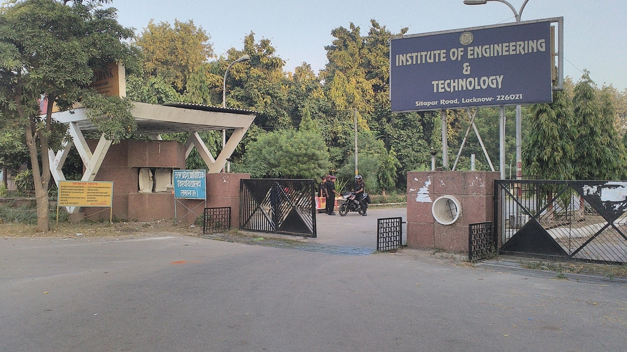
Contact Us
Dr. Arun Kumar Tiwari
Incharge
Training and Placement cell
Email Id.: aruntiwari@ietlucknow.ac.in
Visit us at: www.ietlucknow.ac.in
Shubham Panwar
Student Representative
Training & Placement Cell
Phone.No. +91 9810461646
Email Id.: 1705231055@ietlucknow.ac.in
Ayush Krishna
Student Representative
Training & Placement Cell
Phone.No. +91 7065414964
Email Id.: 1605232021@ietlucknow.ac.in
Harsh Jain
Student Representative
Training & Placement Cell
Phone.No. +91 98716 32346
Email Id.:
1605231017@ietlucknow.ac.in

Slide 14


Reach Us
Training and Placement Cell,
Institute of Engineering and Technology, Lucknow
Sitapur Road, Janakipuram Lucknow - 226021
placement@ietlucknow.ac.in
24 kms from Chaudhary Charan Singh Intn’l Airport, Lucknow
13 kms from Charbagh Railway Station, Lucknow

